Slide 1

DATABASE PRESENTATION
Rojee Koju

Slide 2
Requirements of Project
List which products we currently have in inventory
01
Create new products
02
Modify the amount of a particular product that we have in inventory
03
Delete a product from inventory
04
Get a list of the most popular products for a given time range
05
Get a list of the least popular products for a given time range
06
Get a list of users who haven't purchased something in a few months to send promotional emails to
07

Slide 3
Analysis
Swift Store: Reference by Taylor Swift’s Merchandise Website
Product Management: Includes Catalog, Product entity and Inventory entity
Transaction Management: Include OrderItem and Transaction entity
Users Management: Includes user, location and role entity
Rating System: Include rating entity

Slide 4
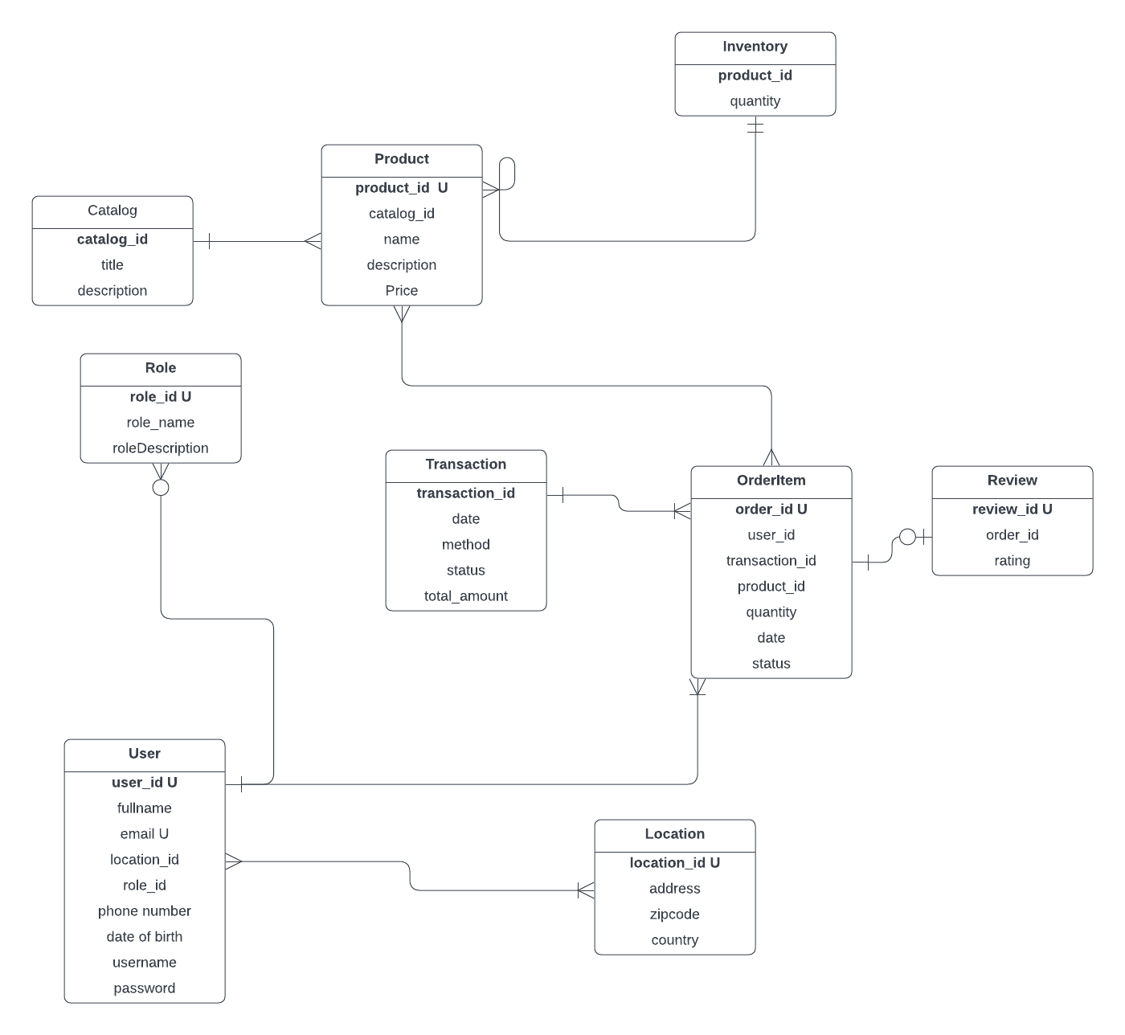
ER DIAGRAM

Slide 5
Discussion
Define properties for attributes
Choose data type according to requirement of data
Set the Primary and Foreign key for attributes
Added constraint , condition for data insertion

Slide 6

Review of Application

Slide 7

Thank You!

